Slide 1
Bias-Variance Tradeoff, Bayesian Classification
Bayes Classification Boundary
Chapt 2

Slide 2
Interpretability vs. Accuracy
Linear Models are more interpretable, but less accurate
Non-linear models are less interpretable, mote more accurate
Non-linear models are more Flexible => they are closer to the ideal function representing input-output relationships

Slide 3
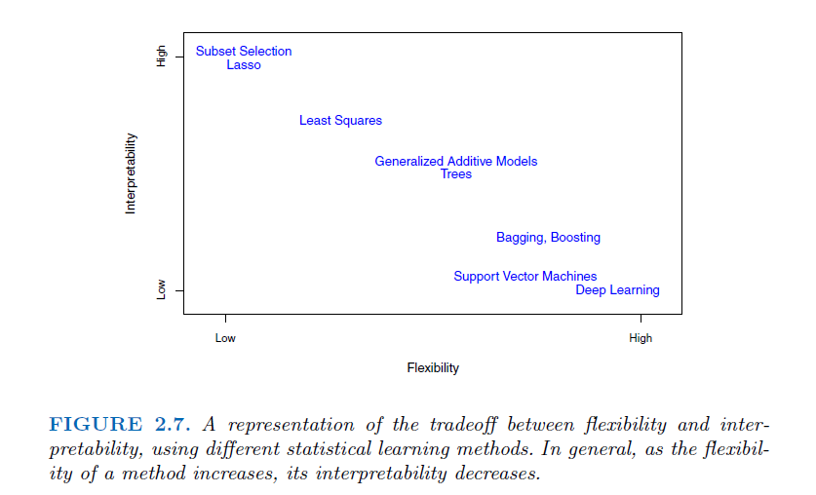

Slide 4
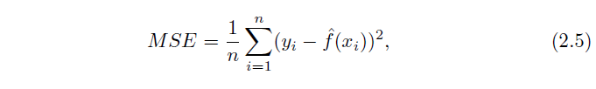
ASSESING MODEL ACCURACY
Model accuracy is determined by the Mean Squared Error (MSE):
Training MSE vs Test MSE
Model Overfitting: When the Test MSE >> Training MSE => Model is too optimized to fit every training data point

Slide 5
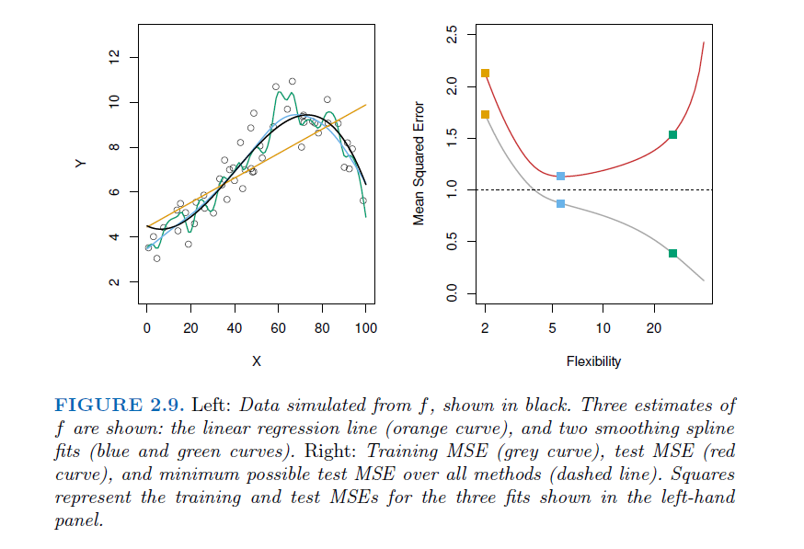

Slide 6
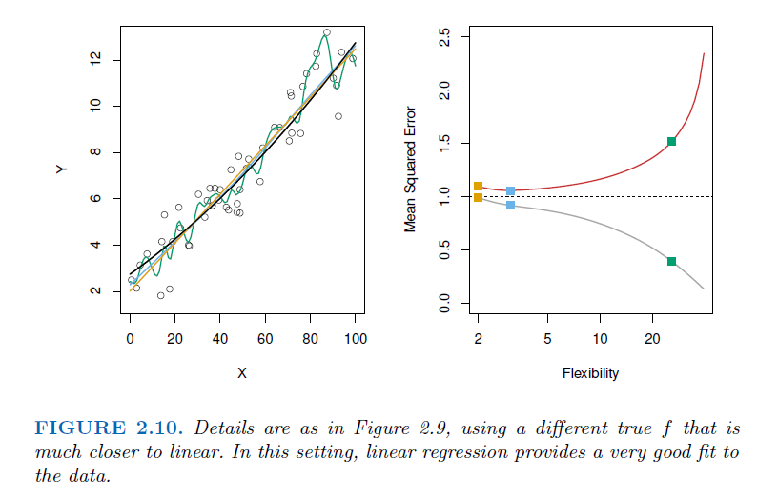

Slide 7
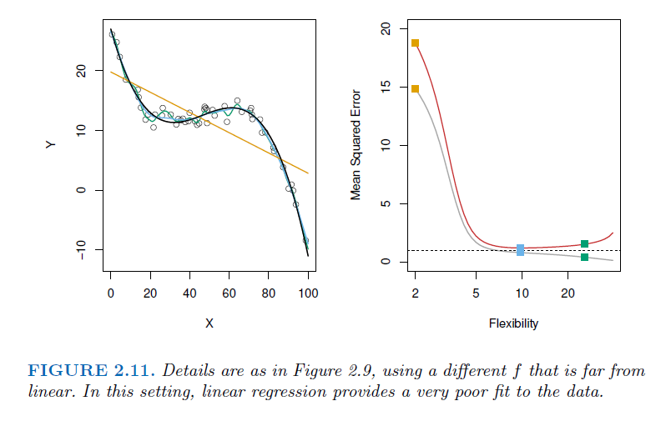

Slide 8

Bias – Variance Tradeoff
The U shape in the Test MSE in the preceding figures is a result of two competing factors, Bias and Variance moving in opposite directions
Expected Value of Test MSE at a given test input Xo has three components:
Variance
Bias

Slide 9
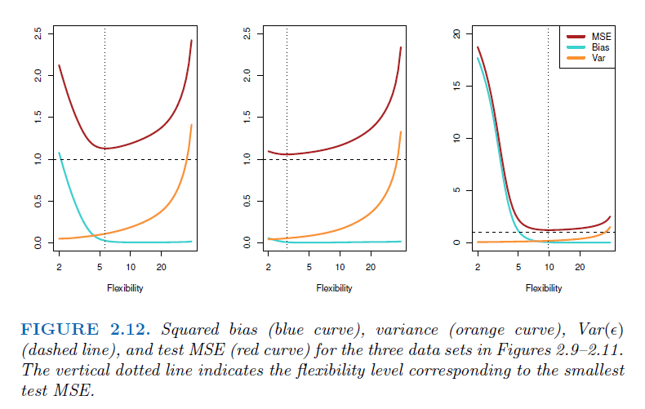

Slide 10

Error Rates in Classification Setting
The training error in a classification setting is given by:
Where, if 0, ith observation was classified
correctly; if 1, it was misclassified.
The test error rate associated with a set of test observations of the form (x0, y0) is given by:

Slide 11
Bayes Classifier: the Gold Standard
The Test Error is minimised by a simple classifier called Bayes Classifer
The Bayes Classifier assigns each observation to the most likely class, given its predictor values
simply assign a test observation with predictor vector x0 to the class j for which
Pr(Y = j|X = x0) (2.10)
is maximum over all j
For a two class scenario, ssign x0 to the class 1 for which this conditional probability is > 0.5, otherwise to class 2.

Slide 12
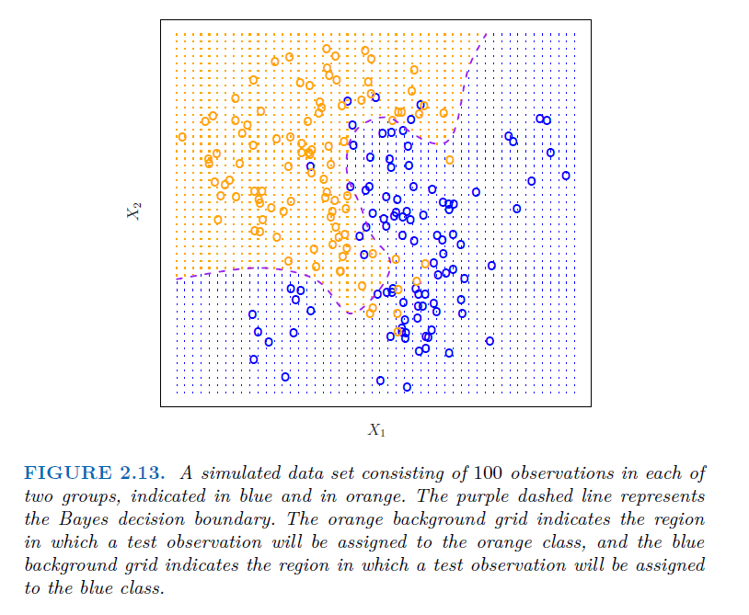
Bayes Decision Boundary

Slide 13

Bayes Error Rate
Using equations (2.9) and (2.10) above, the Bayes Error Rate can be calculated as:
where the expected value E is computed over all values of X
In the previous example, Bayes Error Rate = 0.133

Slide 14

KNN as an Approximation of Bayes Classifier
In the KNN model, an observation Y is assigned to class j if:
This is an approximation of the Bayes Classifier:
since the conditional probability Pr(Y=j|X=x0) is not exactly known, it is estimated by using various values of K

Slide 15
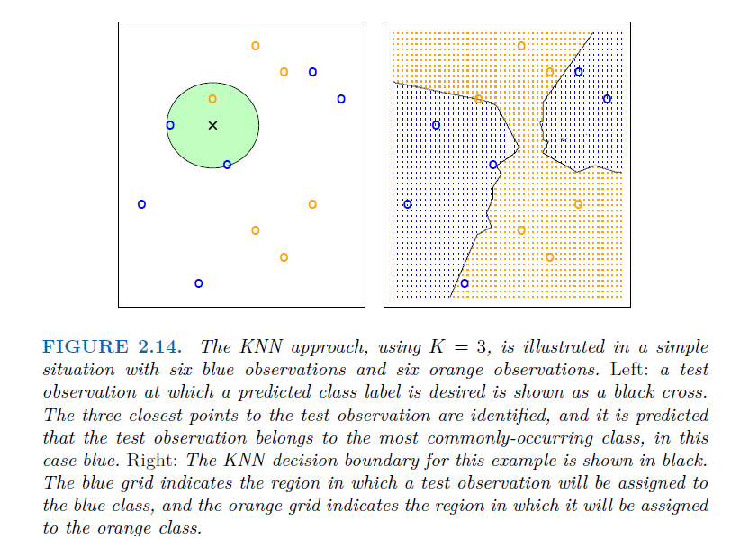


KNN as an Approximation of Bayes Classifier

Slide 16
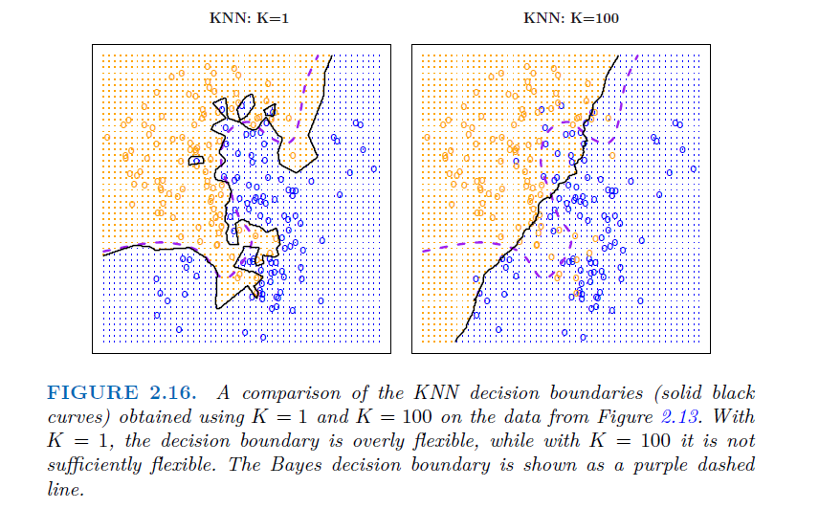
KNN as an Approximation of Bayes Classifier

Slide 17
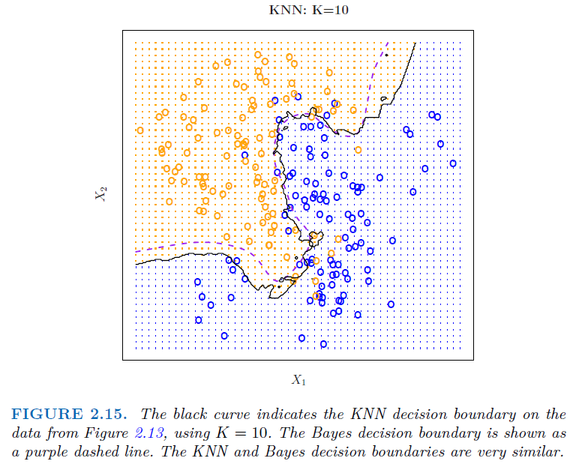
KNN as an Approximation of Bayes Classifier
Optimal
Bayes Decision
Boundary
KNN Decision
Boundary

Slide 18
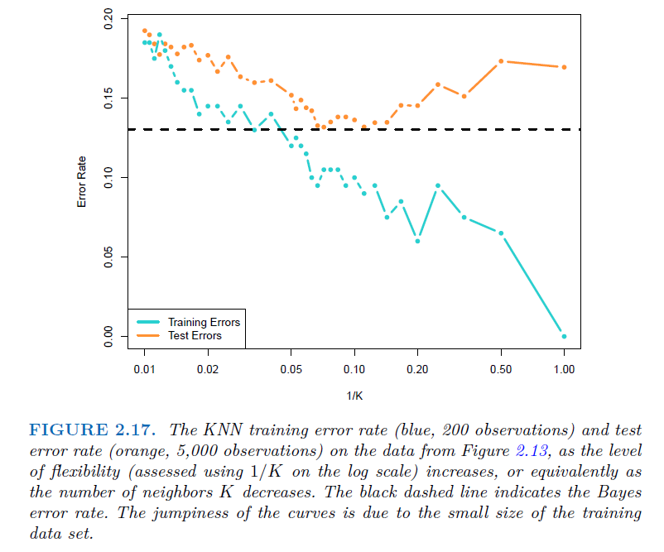
KNN as an Approximation of Bayes Classifier
Optimal K = 10
Test Errors
Baysean: 0.1304
Best KNN: 0.1363

